Slide 1
SystemVerilog Coverage
Copyright © 2021 Intel Corporation.
This document is intended for personal use only.
Unauthorized distribution, modification, public performance,
public display, or copying of this material via any medium is strictly prohibited.

Slide 2
Session Topics
Introduction to Coverage
Functional Coverage
Code Coverage
Functional Vs Code Coverage
Types of Code Coverage
Hands on Lab

Slide 3
Revisit of SystemVerilog Training Part 1
Synthesizable Constructs
Introduction to the SV data type (2 state and 4 state data types)
Implicit .name and .* associations
Specialized always procedural blocks
Enumerated data types

Slide 4
Revisit of SystemVerilog Training Part 2 (Mostly on the Verification constructs)
Packed and Unpacked arrays
Dynamic Arrays
Associative Arrays
Queues
Structures and Unions
Class and Object

Slide 5
Revisit of SystemVerilog Training Part 3
Assertions
Immediate Assertions
Concurrent Assertions
Overlapped Implication
Non-overlapped Implication
$rose and $fell
Assertion statements
Perform simulation using Questa- Intel FPGA starter edition

Slide 6
Key takeaways of the today’s training with demos
Introduction to Coverage
Code Coverage Vs Functional Coverage
Hands on lab to achieve 100% code and assertion coverage
Perform simulation using Questa- Intel FPGA starter edition

Slide 7
Introduction to Coverage
As designs become more complex, the only effective way to verify them effectively is with constrained-random testing (CRT).
This approach elevates you above the tedium of writing individual directed tests, one for each feature in the design.
However, if your testbench is taking a random walk through the space of all design states, how do you know if you have reached your destination? Even directed tests should be double checked with functional coverage.

Slide 8
Functional Coverage
Functional coverage is a measure of which design features have been exercised by the tests.
Start with the design specification and create a verification plan with a detailed list of what to test and how.
For example, if your design connects to a bus, your tests need to exercise all the possible interactions between the design and bus, including relevant design states, delays, and error modes

Slide 9
Functional Coverage
In many complex systems, you may never achieve 100% coverage as schedules don’t allow you to reach every possible corner case.
After all, you didn’t have time to write directed tests to get sufficient coverage, and even CRT is limited by the time it takes you to create and debug test cases and analyze the results.

Slide 10
Functional Coverage
Coverage is defined as the percentage of verification objectives that have been met
Functional verification is used to validate a complex system. The validation should be comprehensive without redundant effort. To minimize wasted effort coverage is used as a guide for identifying tested and untested portions of the design
Functional coverage is a user-defined metric that measures how much of the design specifications, as enumerated by the test plan has been exercised. It can be used to measure whether interesting scenarios, corner cases, specification invariants, or other applicable design conditions (captured by the test plan)- have been observed, validated and tested

Slide 11
Functional Coverage
Defining the Coverage Model
Build a coverage model to measure how well your test plan goals have been exercised.
Can not be automatically inferred from the design.
Functional coverage is a user defined metric that ties verification environment to the design intent or functionality
Based on the DUT spec and test plan, define what needs to be covered.
Steps:
Define coverage group (sampling points)
Define when to sample

Slide 12
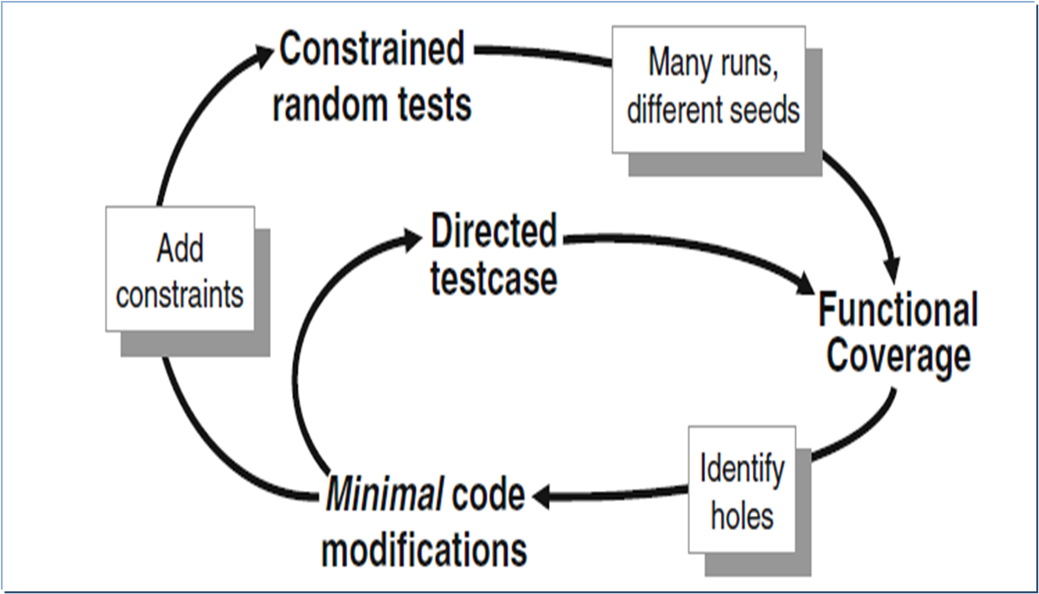
Coverage Convergence

Slide 13
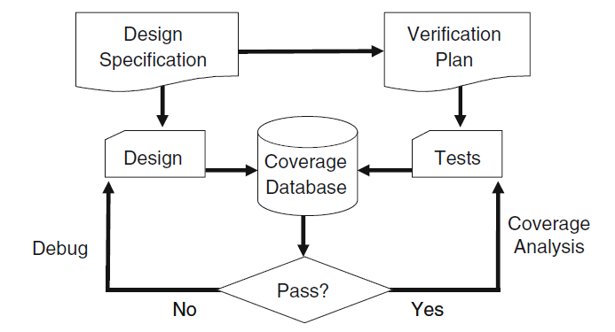
Coverage Flow

Slide 14
Code Coverage
Code coverage tells how well the HDL code has been exercised by the testbench.
Code coverage reports about the efficiency of the test cases that is generated by the testbench.
It is also known as quantitative coverage or structural coverage or implementation coverage since it reports the efficiency of the verification implementation.

Slide 15
Types of Code Coverage
Statement or Line Coverage
Block or Segment Coverage
Condition/ Expression Coverage /Focused Expression Coverage
Branch/ Decision Coverage
Toggle Coverage
Path Coverage or Extended Branch Coverage
FSM coverage

Slide 16
Statement or Line Coverage
Statement or Line Coverage gives an indication of how many executable statements (lines) are covered in the simulation, by excluding lines like module, endmodule, comments, timescale etc.
This coverage is very important in all kinds of design and must be 100% for verification closure.
Statement coverage includes procedural statements, continuous assignment statements, conditional statement, and Branches for conditional statements etc.

Slide 17
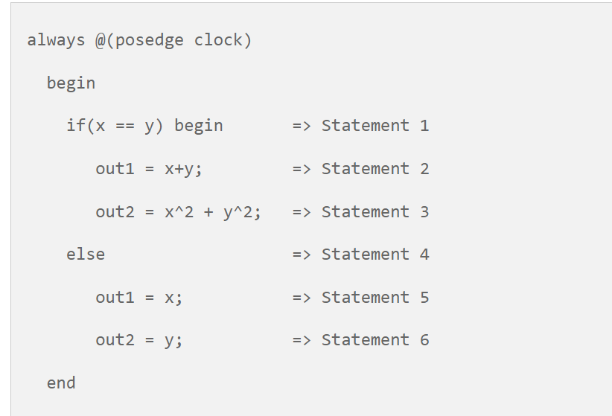
Statement or Line Coverage

Slide 18
Block or Segment Coverage
A group of statements which are in the begin-end or if-else or case or wait or while loop or for loop etc. is called a block.
Block coverage gives the indication that whether these blocks are covered in simulation or not.
The dead-code in design code can be found by analyzing block coverage.

Slide 19
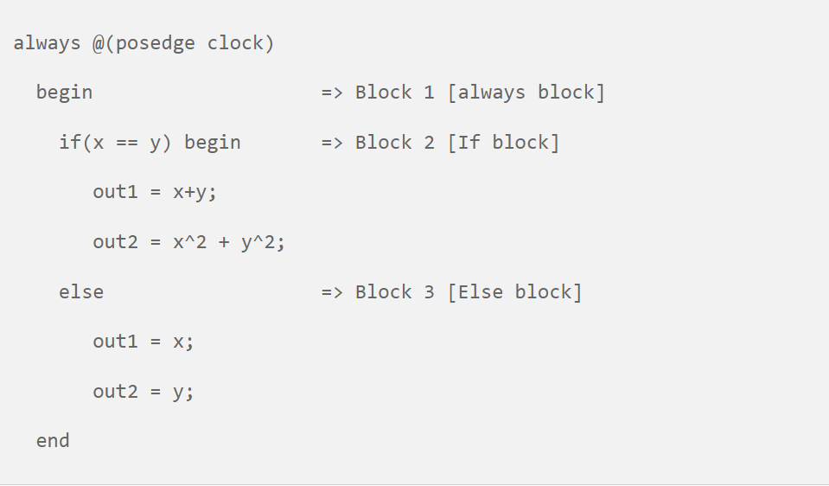
Block or Segment Coverage

Slide 20
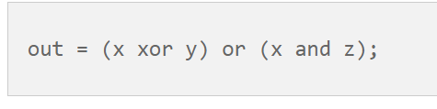
Condition or Expression coverage
This gives an indication how well variables and expressions (with logical operators) in conditional statements are evaluated.
Conditional coverage is the ratio of number of cases evaluated to the total number of cases present.
If an expression has Boolean operations like XOR, AND, OR etc the entries which is given to that expression to the total possibilities are indicated by expression coverage.

Slide 21
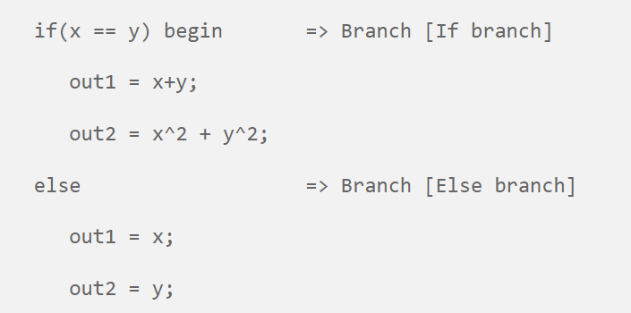
Branch or Decision Coverage
In Branch coverage or Decision coverage reports, conditions like if-else, case and the ternary operator (?: ) statements are evaluated in both true and false cases.

Slide 22
Toggle Coverage
Toggle coverage gives a report that how many times signals and ports are toggled during a simulation run. It also measures activity in the design, such as unused signals or signals that remain constant or less value changes.

Slide 23
Path or Extended branch coverage
Path coverage tests all paths in the code. A code path is the execution of the module’s entry point to the exit point.
Path coverage is more complicated than statement and branch coverage because the code may contain an unlimited number of paths.

Slide 24
FSM Coverage
FSM coverage reports, whether the simulation run could reach all the states and cover all possible transitions or arcs in a given state machine.
This is a complex coverage type as it works on behavior of the design, that means it interprets the synthesis semantics of the HDL design and monitors the coverage of the FSM representation of control logic blocks.

Slide 25
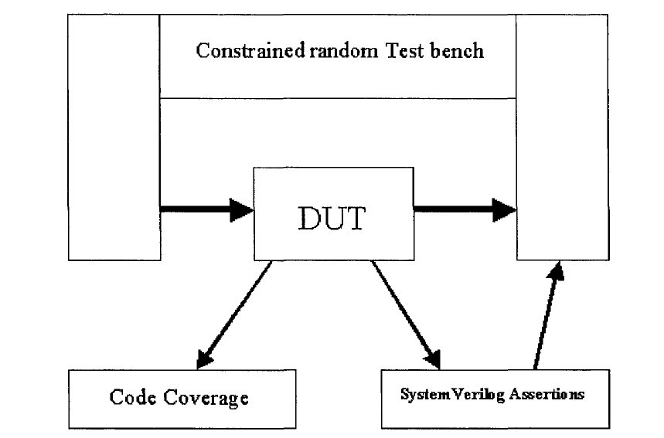
After SystemVerilog Assertions

Slide 26
Limitations of Code-Coverage
Code coverage is an important indication for the verification engineer on how well the design code has been executed by the tests.
But it does not know anything about the design and what the design is supposed to do.
There is no way to find what is missing in the RTL code, as code coverage can only tell quality of the implemented code.

Slide 27
Limitations of Code-Coverage
Code coverage measures how thoroughly your tests exercised the “implementation” of the design specification, but not the verification plan.
Just because your tests have reached 100% code coverage, your job is not done.
What if you made a mistake that your test didn’t catch? Worse yet, what if your implementation is missing a feature?

Slide 28
Functional Vs Code Coverage
Functional coverage is tied to the design intent and is sometimes called “specification coverage,” while code coverage measures how well you have tested the RTL code and is known as, “implementation coverage.”
These are two very different metrics. Consider what happens if a block of code is missing from the design.
Code coverage cannot catch this mistake and could report that you have executed 100% of the lines, but functional coverage will show that the functionality does not exist.

Slide 29
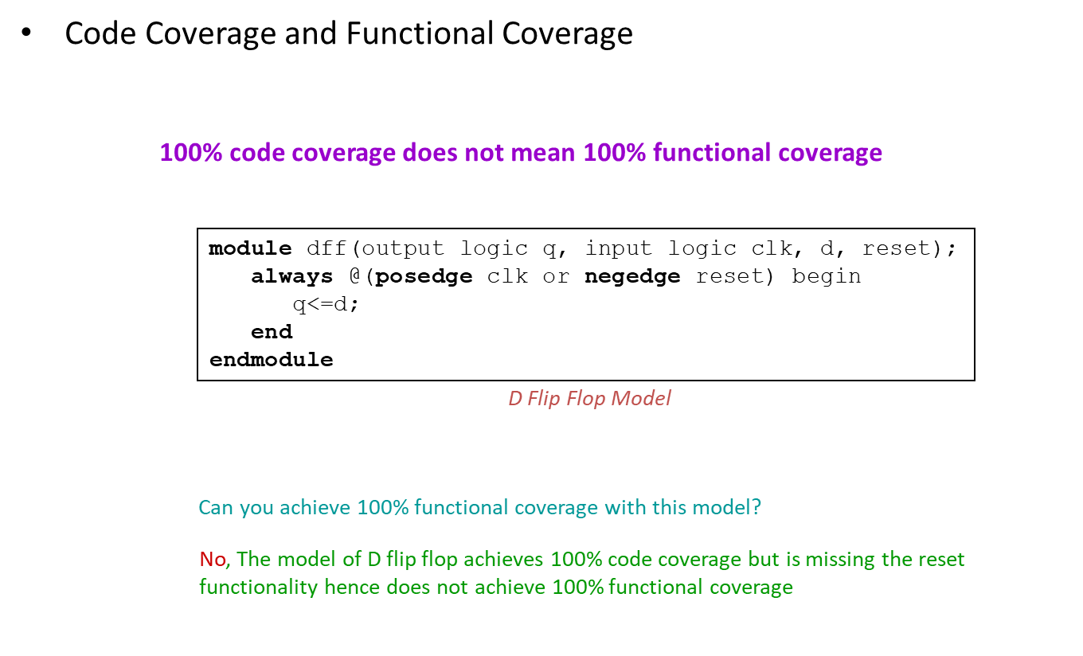
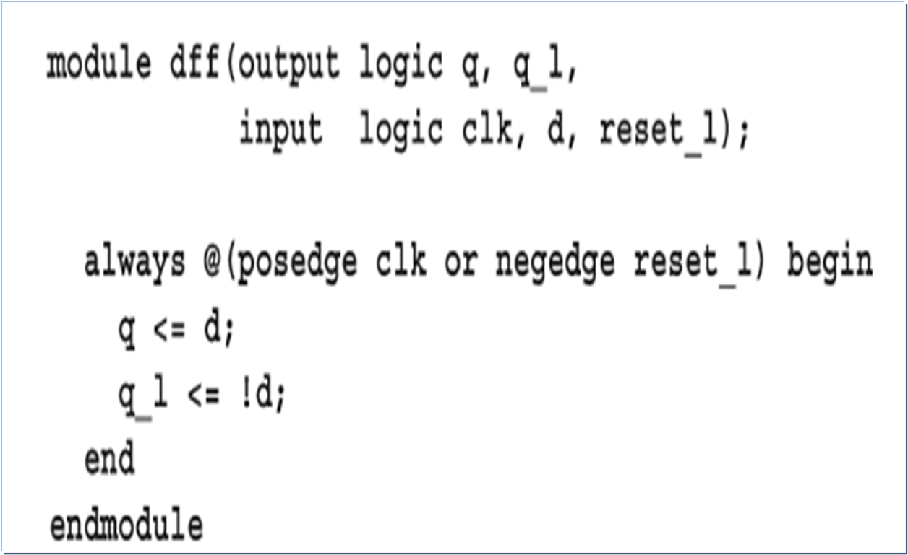
Code Vs Functional Coverage

Slide 30
Incomplete DFF
The reset logic was accidently left out. A code coverage tool would report that every line had been exercised, yet the model was not implemented correctly.
Go back to the functional specification that describes reset behavior and make sure your verification plan includes a requirement to verify this.
Then gather functional coverage information on the design during reset.

Slide 31
Incomplete DFF
The goal of verification is to ensure that a design behaves correctly in its real environment, be that an MP3 player, network router, or cell phone.
The design specification details how the device should operate, whereas the verification plan lists how that functionality is to be stimulated, verified, and measured.
When you gather measurements on what functions were covered, you are performing “design” coverage.
For example, the verification plan for a D-flip flop would mention not only its data storage but also how it resets to a known state. Until your test checks both these design features, you will not have 100% functional coverage.

Slide 32
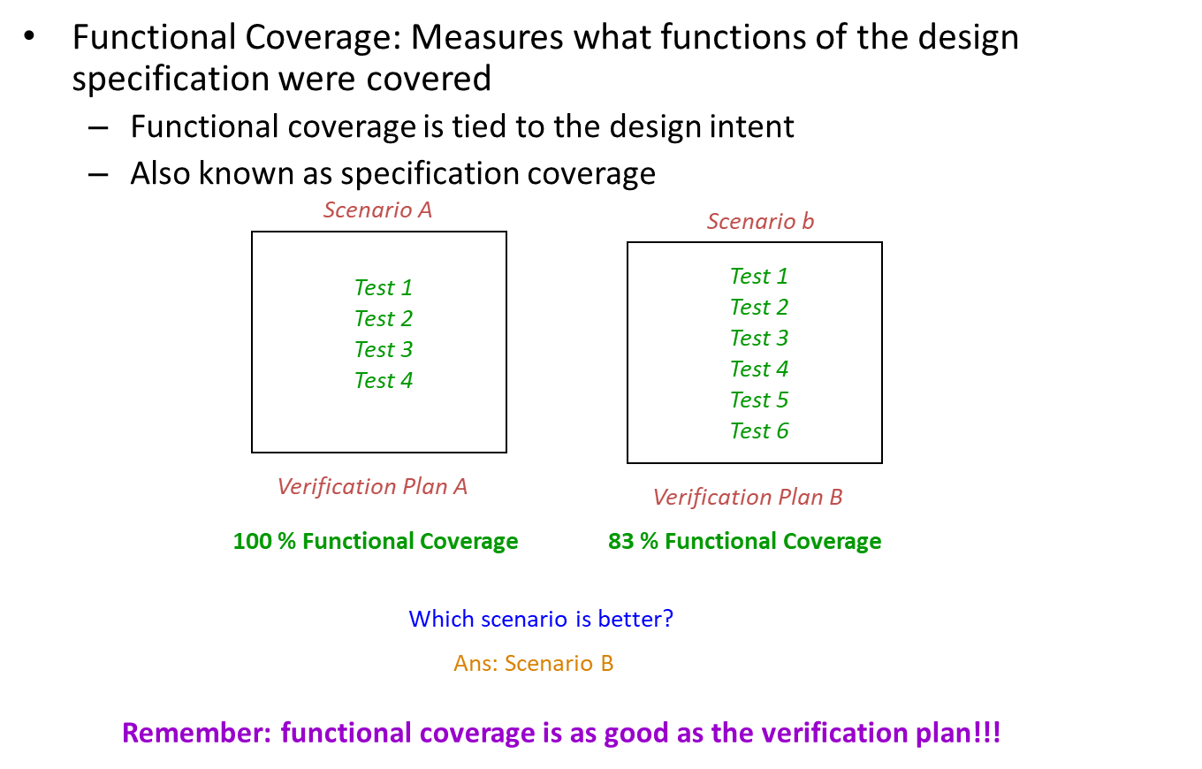
Functional Coverage

Slide 33
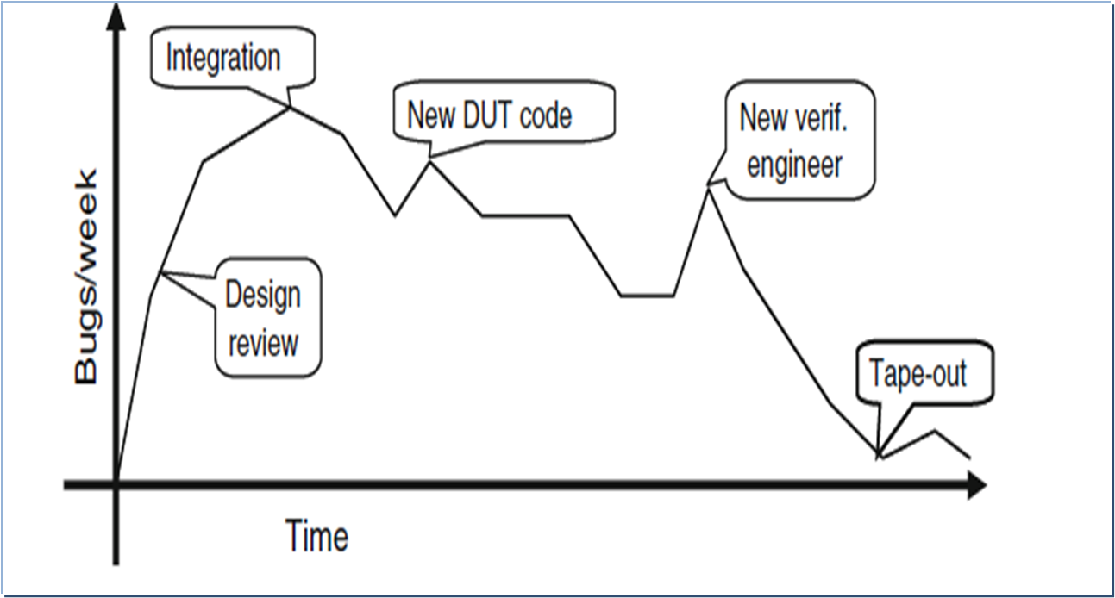
Bug rate during a Project

Slide 34
Gather Information Not Data
The corner cases for a FIFO are Full and Empty.
If you can make the FIFO, go from Empty (the state after reset) through Full and back down to Empty, you have covered all the levels in between.
Other interesting states involve the indices as they pass between all 1’s and all 0’s. A coverage report for these cases is easy to understand.

Slide 35
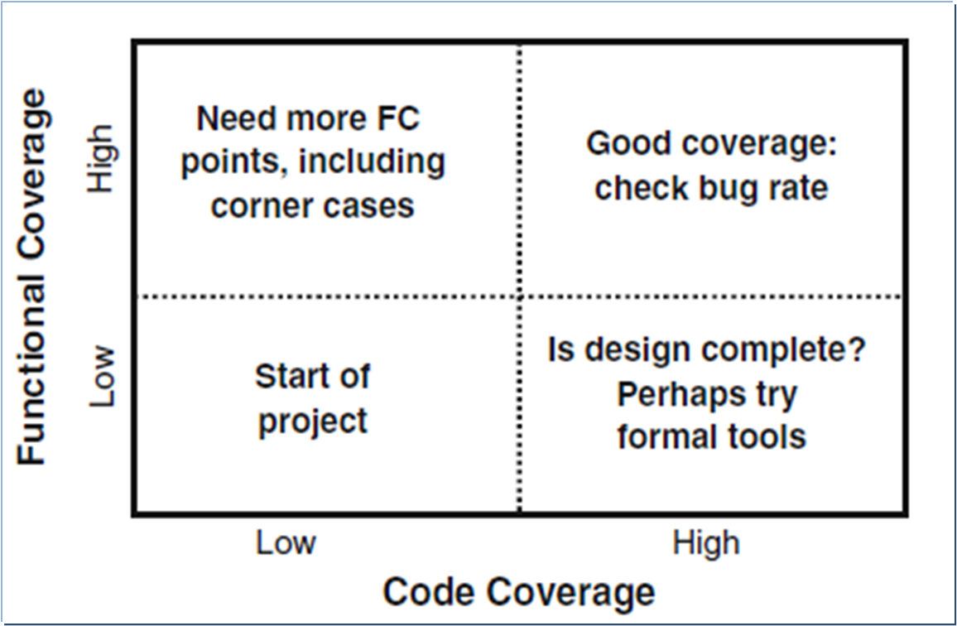
Coverage Comparison

Slide 36
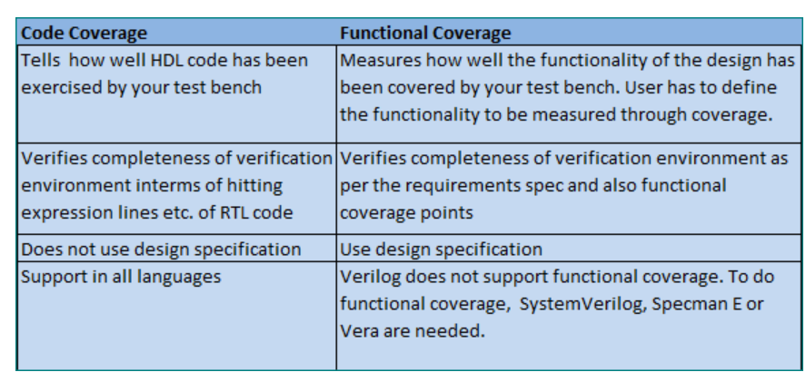
Code Coverage Vs Functional Coverage

Slide 37
Summary of the Key take aways
Introduction to Coverage
Code Coverage Vs Functional Coverage
Hands on lab to achieve 100% code and assertion coverage
Perform simulation using Questa- Intel FPGA starter edition

Slide 38
References
SystemVerilog for Verification – Chris Spear

Slide 39
Legal Disclaimers/Acknowledgements
Intel technologies may require enabled hardware, software or service activation
No product or component can be absolutely secure
Your costs and results may vary
Intel, the Intel logo, and other Intel marks are trademarks of Intel Corporation or its subsidiaries. Other names and brands may be claimed as the property of others
OpenCL and the OpenCL logo are trademarks of Apple Inc. used by permission by Khronos
*Other names and brands may be claimed as the property of others

Slide 40
Legal Disclaimers/Acknowledgements
If the presentation includes any performance claims, use this slide instead of slide 10 (and remove this box). Also, follow steps 2-5 on https://legal.intel.com/Marketing/Pages/Notices%20and%20Disclaimers.aspx.
Software and workloads used in performance tests may have been optimized for performance only on Intel microprocessors.
Performance tests, such as SYSmark and MobileMark, are measured using specific computer systems, components, software, operations and functions. Any change to any of those factors may cause the results to vary. You should consult other information and performance tests to assist you in fully evaluating your contemplated purchases, including the performance of that product when combined with other products. For more complete information visit www.intel.com/benchmarks.
Performance results are based on testing as of dates shown in configurations and may not reflect all publicly available ​updates. See backup for configuration details. No product or component can be absolutely secure.
Your costs and results may vary.
Intel technologies may require enabled hardware, software or service activation
No product or component can be absolutely secure
Your costs and results may vary
Intel, the Intel logo, and other Intel marks are trademarks of Intel Corporation or its subsidiaries. Other names and brands may be claimed as the property of others
OpenCL and the OpenCL logo are trademarks of Apple Inc. used by permission by Khronos
*Other names and brands may be claimed as the property of others

Slide 41
Copyright © 2021 Intel Corporation. This document is intended for personal use only. Unauthorized distribution, modification, public performance, public display, or copying of this material via any medium is strictly prohibited.

